Slide 1
Attributes
Guideline: Represent what may initially be considered a number or string as a new data type class in the domain model if:
  It is composed of separate sections: phone number, name of person
  There are operations associated with it, such as parsing or validation.
    social security number

Slide 2
Attributes
  It has other attributes.
    promotional price could have a start (effective) date and end date
  It is a quantity with a unit.
    payment amount has a unit of currency
  It is an abstraction of one or more types with some of these qualities.
    item identifier in the sales domain is a generalization of types such as Universal Product Code (UPC) and European Article Number (EAN)

Slide 3
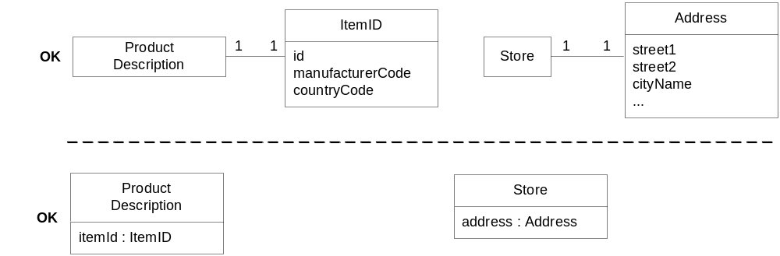
Attributes
Applying UML: Two ways to indicate a data type property of an object.

Slide 4
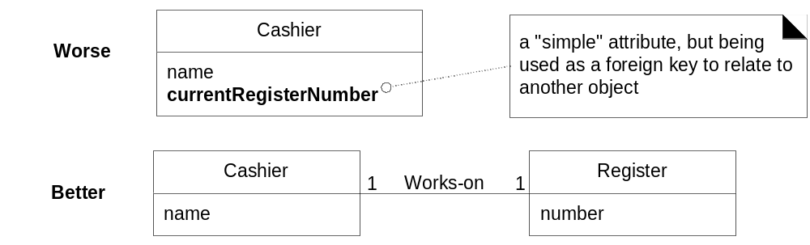
Attributes
Guideline: No Attributes Representing Foreign Keys.

Slide 5
Attributes
Guideline: Modeling Quantities and Units.
  Most numeric quantities should not be represented as plain numbers.
  To represent Quantity as a distinct class, with an associated Unit.
  To show Quantity specializations. Money is a kind of quantity whose units are currencies. Weight is a quantity with units such as kilograms or pounds.

Slide 6
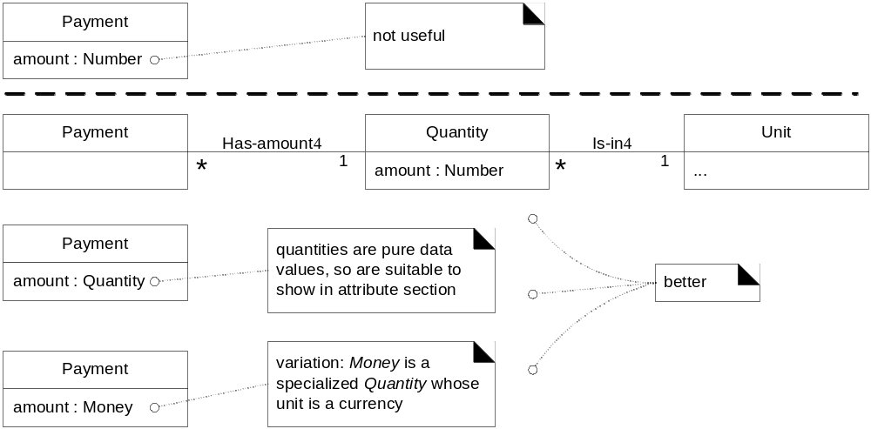
Attributes

Slide 7
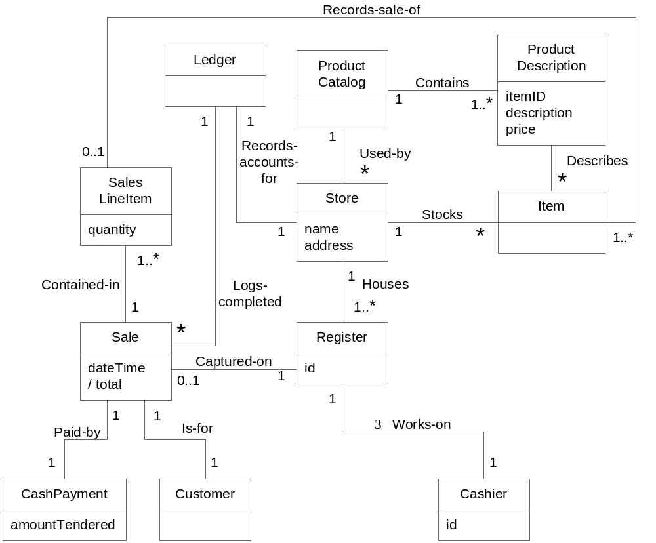
POS Partial Domain Model

Slide 8
Is the Domain Model correct?
There is no such thing as single correct domain model
All models are approximation of the domain we are attempting to understand
It is a tool for understanding the concept, terminology & relationship
Used for communicating among a particular group.

Slide 9
Iterative and Evolutionary Domain Modeling
Discipline
Artifact
Incep.
Elab.
Const.
Trans.
Iteration
I1
E1..En
C1..Cn
T1..T2
Business Modeling
Domain Model
s
Requirements
Use-Case Model (SSDs)
s
r
Vision
s
r
Supplementary Specification
s
r
Glossary
s
r
Design
Design Model
s
r
SW Architecture Document
s
Data Model
s
r
S-start, r-refine

Slide 10
2.3 Representation of system behavior

Slide 11
Iteration 1-Inception
First real development iteration.
The requirement work done during inception phase was to decide if the project was worth more serious investigation.
Before starting iteration 1 design work, further investigation of the problem domain is useful such as clarification of the input and output system events, related to the system.

Slide 12
Elaboration-Iteration 2
Class diagrams represent static relationships.
What about modeling dynamic behavior?
Interaction diagrams model how groups of object
collaborate to perform some behavior
  Typically captures the behavior of a single use case.

Slide 13
USE CASE & SSD
The use case; suggest interaction of an actor with the software system.
During this interaction the actor generates events to a system, requesting some response from the system.
It is desirable to isolate and illustrate the operation that an actor request of a system because they are important part of understanding system behavior

Slide 14
USE CASE & SSD
The UML includes Sequence diagrams as a notation that can illustrate actor interaction and the operation initiated by them
“A SEQUENCE Diagram is a picture that shows, for a particular scenario of use case, events that external actor generates their order, and inter system events”
All the System are treated as BALCK BOX.

Slide 15
USE CASE & SSD
The UML includes sequence diagrams as a notation that can illustrate actor interactions and the operations initiated by them.
A system sequence diagram (SSD) is a picture that shows, for a particular scenario of a use case, the events that external actors generate, their order, and inter-system events.

Slide 16
USE CASE & SSD
An SSD shows system events for a scenario of a use case, therefore it is generated from inspection of a use case
SYSTEM BEHAVIOR
It is a description of what system does, without explaining how system does it.

Slide 17
SSD versus Sequence Diagram
A System Sequence Diagram is an artifact that illustrates input and output events related to the system under discussion.
System Sequence Diagrams are typically associated with use-case realization in the logical view of system development.
Sequence Diagrams (Not System Sequence Diagrams) display object interactions arranged in time sequence.

Slide 18
Sequence Diagrams
Sequence Diagrams depict the objects and classes involved in the scenario and the sequence of messages exchanged between the objects needed to carry out the functionality of the system.
Sequence diagrams can be used to drive out testable user interface requirements.

Slide 19
SSD—System Behavior
System behaves as “Black Box”.
Interior objects are not shown, as they would be on a Sequence Diagram.
:System

Slide 20
System Sequence Diagrams
Use cases describe-
How actors interact with system.
Typical course of events that external actors generate and
The order of the events.

Slide 21
System Sequence
Diagrams(2)
For a particular scenario of use-case an SSD shows-
The external actors that interact directly with the system.
The System (as a black box).
The system events that the actors generate.

Slide 22
System Sequence
Diagrams(3)
The operations of the system in response to the events generated.
System Sequence Diagrams depict the temporal order of the events.
System Sequence Diagrams should be done for the main success scenario of the use-case, and frequent and alternative scenarios.

Slide 23
Notation
Object: Objects are instances of classes. Object is represented as a rectangle which contains the name of the object underlined.
Because the system is instantiated, it is shown as an object.
:Object1

Slide 24
Notation (2)
Actor: An Actor is modeled using the ubiquitous symbol, the stick figure.
actor1

Slide 25
Notation (3)
Lifeline: The LifeLine identifies the existence of the object over time. The notation for a Lifeline is a vertical dotted line extending from an object.

Slide 26
Notation (4)
Message: Messages, modeled as horizontal arrows between Activations, indicate the communications between objects.
messageName(argument)

Slide 27
Example of an SSD
Following example shows the success scenario of the Process Sale use case.
Events generated by cashier (actor)-
makeNewSale
      enterItem
      endSale and
      makePayment.

Slide 28
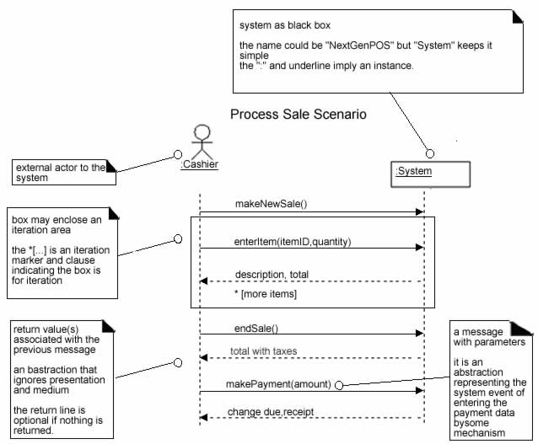

Slide 29
System Sequence Diagrams and Use Cases
System Sequence Diagram is generated from inspection of a use case.
Constructing a systems sequence diagram from a use case-
1.Draw a line representing the system as a black box.
2.Identify each actor that directly operates on the system. Draw a line for each such actor.

Slide 30
System Sequence Diagrams and Use Cases
3.From the use case, typical course of events text, identify the system (external) events that each actor generates. They will correspond to an entry in the right hand side of the typical use case. Illustrate them on the diagram.
4.Optionally, include the use case text to the left of the diagram.

Slide 31
System Events and System Boundary
To identify the system events, system boundary is critical.
For the purpose of software development, the system boundary is chosen to be the software system itself.

Slide 32
System Events and System Boundary(2)
Identifying the System events-
Determine the actors that directly interact with the system.
In the process Sale example, the customer does not directly interact with the POS system. Cashier interacts with the system directly. Therefore cashier is the generator of the system events.

Slide 33
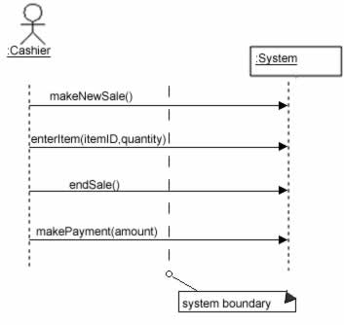
Defining system boundary.

Slide 34
Naming System Events and Operations
System event
External input event generated by an actor.
Initiates a responding operation by system.
System operation
Operation invoked in response to system event.

Slide 35
Naming System Events and Operations(2)
System events and their associated system operations should be expressed at the level of intent rather than in terms of the physical input medium or widget.
In order to improve the clarity, it is appropriate to start the name of the system event with a verb (for example- add….,enter….,end….,make…. etc.,). It also emphasizes the command origination of these events.

Slide 36
Naming System Events and Operations(3)
For example “enterItem” is better than “scan” as it captures the intent of operation rather than what interface is used to capture the system event (design choice).

Slide 37
Simple Cash only Process Sale Scenario
1.Customer arrives at a POS checkout with goods and or services to purchase
2.Cashier starts a new sale
3.Cashier enters item identifier
4.System records sale line item and presents item description , price and running total Cashier repeats steps 3-4 times until indicates done
5.System presents total with taxes calculated
6.Cashier tells customer the total and asks for payment
7.Customer pays and system handles payment

Slide 38
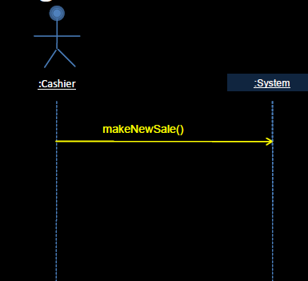
Simple Cash only Process Sale Scenario

Slide 39
Simple Cash only Process Sale Scenario
Simple Cash only Process Sale Scenario
1.Customer arrives at a POS checkout with goods and or services to purchase
2.Cashier starts a new sale
3.Cashier enters item identifier
4.System records sale line item and presents item description , price and running total Cashier repeats steps 3-4 times until indicates done
5.System presents total with taxes calculated
6.Cashier tells customer the total and asks for payment
7.Customer pays and system handles payment

Slide 40
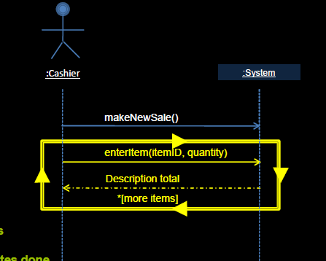
Simple Cash only Process Sale Scenario

Slide 41
Simple Cash only Process Sale Scenario
Simple Cash only Process Sale Scenario
1.Customer arrives at a POS checkout with goods and or services to purchase
2.Cashier starts a new sale
3.Cashier enters item identifier
4.System records sale line item and presents item description , price and running total Cashier repeats steps 3-4 times until indicates done
5.System presents total with taxes calculated
6.Cashier tells customer the total, asks for payment
7.Customer pays and system handles payment

Slide 42
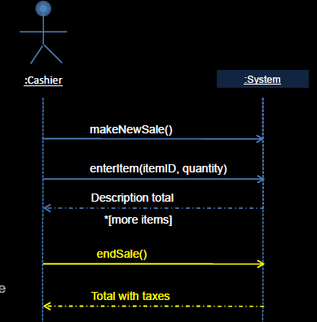
Simple Cash only Process Sale Scenario

Slide 43
Simple Cash only Process Sale Scenario
1.Customer arrives at a POS checkout with goods and or services to purchase
2.Cashier starts a new sale
3.Cashier enters item identifier
4.System records sale line item and presents item description , price and running total Cashier repeats steps 3-4 times until indicates done
5.System presents total with taxes calculated
6.Cashier tells customer the total and asks for payment
7.Customer pays and system handles payment

Slide 44
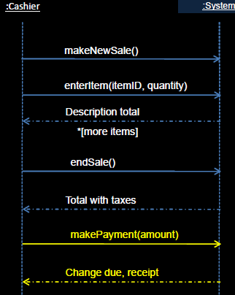
Simple Cash only Process Sale Scenario

Slide 45
Naming System Events and Operations
System events (and their associated system operations) should be expressed at the level of intent rather than in terms of the physical input medium or interface widget level.
It also improves clarity to start the name of a system event with a verb(add..., enter..., end..., make...), as in since it emphasizes the command orientation of these events.

Slide 46
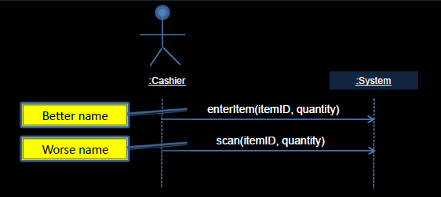
Naming System Events and Operations

Slide 47
Operation Contracts
Use cases are the primary mechanism in the UP to describe system behavior, and are usually sufficient.
However, sometimes a more detailed description of system behavior has value.
Contracts for operations can help define system behavior.
A Domain Model
A visual representation of conceptual classes or real-world objects in a domain of interest.
Contracts
A detailed system behavior in terms of state changes to objects in the Domain Model, after a system operation has executed.

Slide 48
Operation Contracts
Operation: Name of operation, and parameters.
Cross References: Use cases this can occur within. (optional)
Preconditions: Noteworthy assumptions about the state of the system or objects in the Domain Model before execution of the operation.
Post conditions: The state of objects in the Domain Model after completion of the operation

Slide 49
Operation Contracts
Post conditions are not actions to be performed, during the operation; rather, they are declarations about the Domain Model objects that are true when the operation has finished. after the smoke has cleared.
Express post conditions in the past tense, to emphasize they are declarations about a state change in the past.
(better) A SalesLineItem was created.
(worse) Create a SalesLineItem.

Slide 50
Contract CO2: enterItem
Operation: enterItem(itemID : ItemID,quantity : integer)
Cross References: Use Cases: Process
SalePreconditions:There is a Sale Underway.
Postconditions:A SalesLineItem instance sli was created (instance creation)-sli was associated with thecurrent Sale (association formed)-sli.quantity became quantity(attribute modification)-sli was associated with aProductSpecification, based onitemID match (association formed)

Slide 51
Example-SSD-Student enrolling in a University

Slide 52
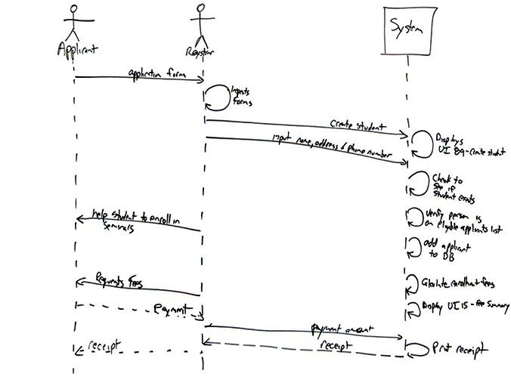


Slide 53
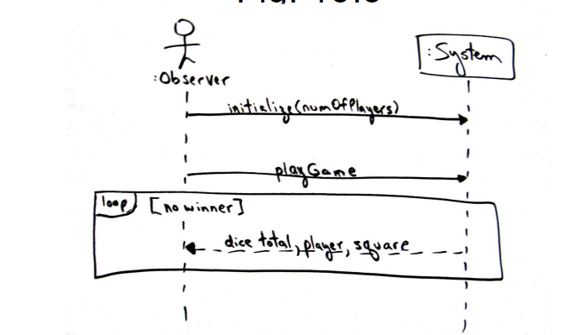
Example 2-Dice Game

Slide 54
System Sequence Diagrams Within the Unified Process
Elaboration: It is useful to create System Sequence Diagrams during elaboration in order to -
Identify the system events and major operations.
To write system operation contracts (Contracts describe detailed system behavior) and
To support estimation.

Slide 55
Conclusion
System Sequence Diagrams provide a way for us to visually step through invocation of the operations defined by Use-Cases.
It is not necessary to create SSDs for all scenarios of all use-cases,at least not at the same time.

